Slide 1

Natural Language Processing
Yue Zhang
Westlake University

Slide 2
Overview
Week 2
Overview of NLP architecture
Data and Model
Review of background
Linear Models
Week 3
Week 4
Week 5
Week 6
Week 7
N-gram Language Models
Naïve Bayes
Generative Text Classification
Features
Document Representation
Discriminative Text Classification
Neuron
SGD
Entropy, Perplexity
Word Representation
HMM -- Generative Sturctured Prediction
CRF – Discriminative Structured Prediction
Neural Models
Week 8
Week 10
Week 12
MLP, Multi-Layer Perception
Neural N-gram LM and Word Embedding
Neural Structured Prediction
Sequence-to-sequence
Neural Recurrent Language Models
Week 9
Week 13
Sequence Representation
Neural Text Classification
Week 11
Sequence-level Pre-training
Pre-trained Models for Text Classification and other MLP tasks
Structured Representation
Large Language Models
Week 14
Week 15
Scaling, instruction following and LLMs
LLMs for NLP, AGI and beyond

Slide 3
Week 7
Sequence Labeling

Slide 4
Contents
7.1 Structured Prediction and Sequence Labelling
7.2 Hidden Markov Models —— Generative Models
7.2.1 Training Hidden Markov Models
7.2.2 Decoding
7.3 Maximum Entropy Markov Models
7.4 Conditional random fields
7.4.1 Global modeling
7.4.2 Decoding
7.4.3 Training

Slide 5
Contents
7.1 Structured Prediction and Sequence Labelling
7.2 Hidden Markov Models —— Generative Models
7.2.1 Training Hidden Markov Models
7.2.2 Decoding
7.3 Maximum Entropy Markov Models
7.4 Conditional random fields
7.4.1 Global modeling
7.4.2 Decoding
7.4.3 Training

Slide 6
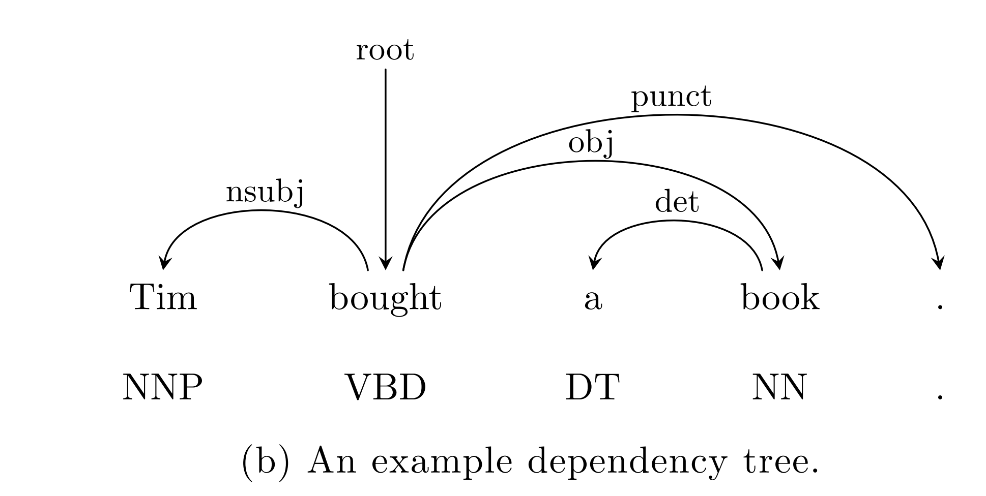
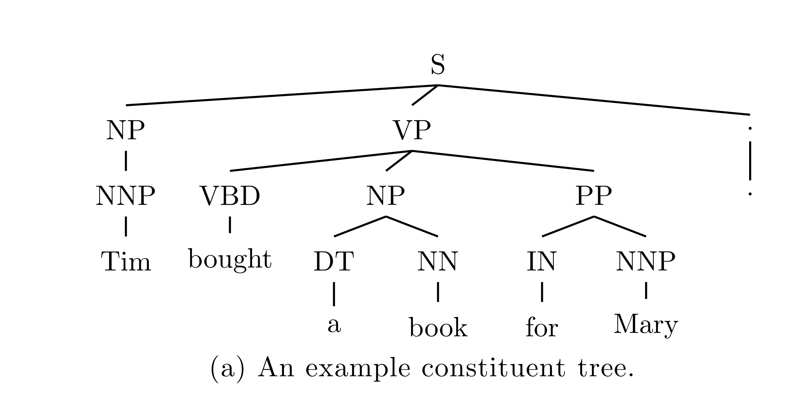
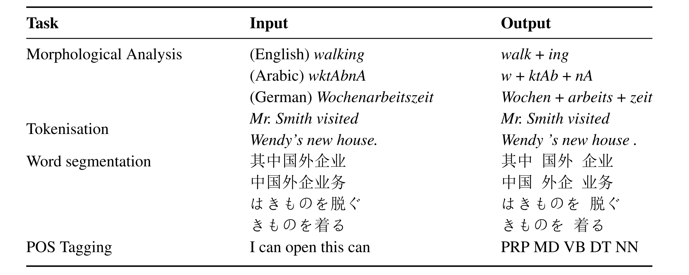
Structure Prediction
Output is a structure
Notes:
Figure error with row 1

Slide 7
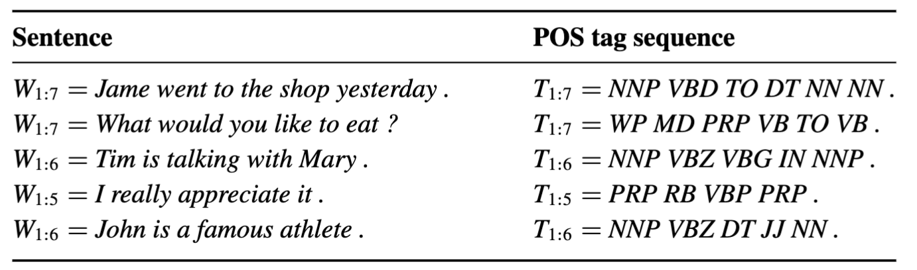
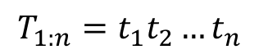
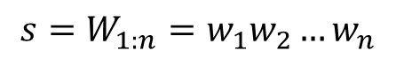
Sequence Labelling
Part-of-Speech tagging as example
Input is a sentence
Output is a sequence of POS tags
$$s=W_{1:n}=w_{1}w_{2}…w_{n}$$
$$T_{1:n}=t_{1}t_{2}…t_{n}$$
NNP：Proper Noun VBD：Verb, past tense TO: to NN: Noun
Notes:
Figure error with row 1

Slide 8
Sequence Labelling
Part-of-Speech tagging as example
Input is a sentence
Output is a sequence of POS tags
$$s=W_{1:n}=w_{1}w_{2}…w_{n}$$
$$T_{1:n}=t_{1}t_{2}…t_{n}$$
James went to the shop yesterday . NNP VBD TO DT NN NN .
James|NNP went|VBD to|TO the|DT park|NN yesterday|NN .|.
NNP：Proper Noun VBD：Verb, past tense TO: to NN: Noun
Notes:
Figure error with row 1

Slide 9
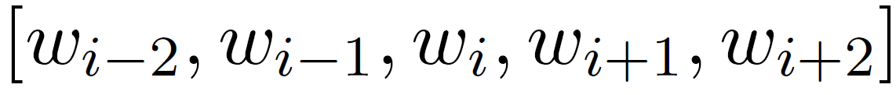
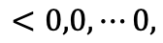
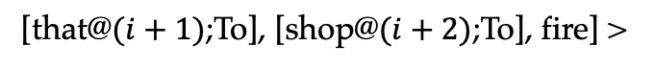
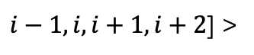


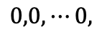
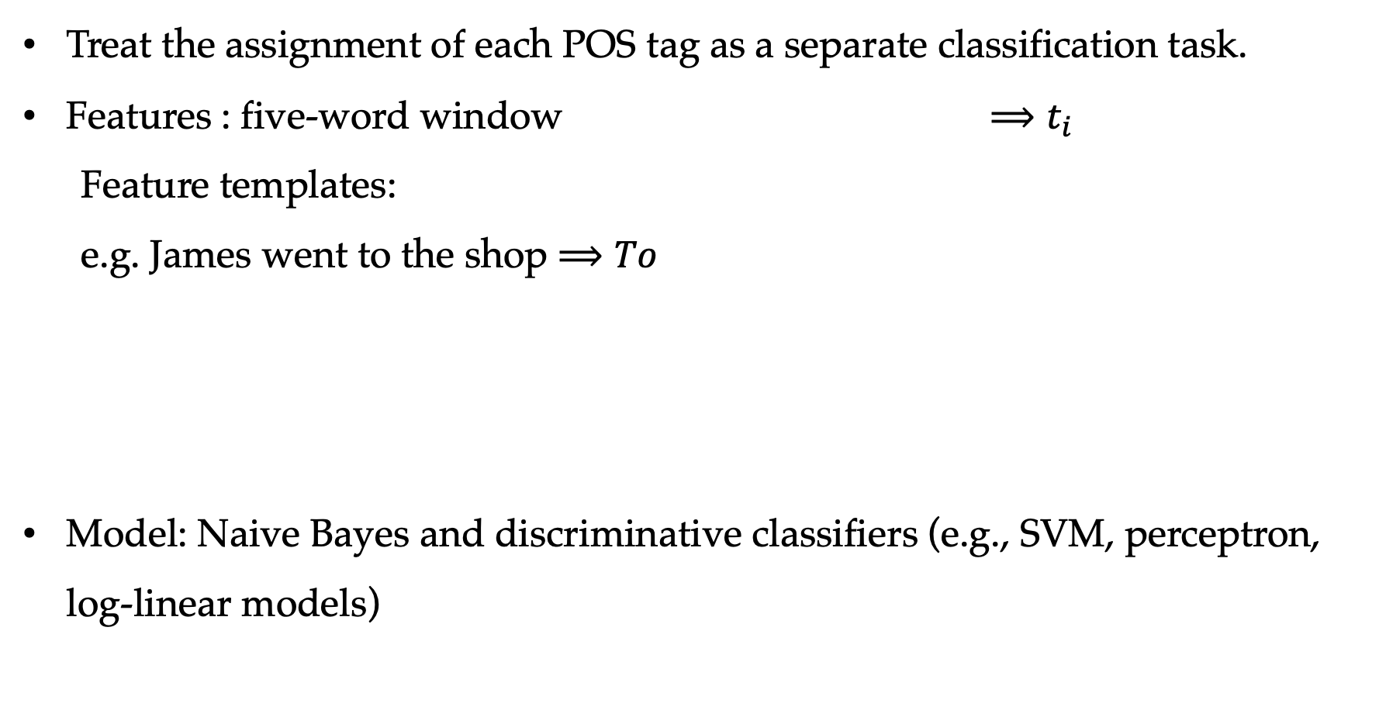
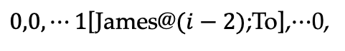
Local Model
Treat the assignment of each POS tag as a separate classification task.
Features : five-word window $⟹t_{i}$
Feature templates:
e.g. James went to the shop $⟹To$
Model: Naive Bayes and discriminative classifiers (e.g., SVM, perceptron, log-linear models)
$$<0,0,⋯0,$$
$$⋯$$
$<ω_{1}∙l_{1}\left(i−2\right),ω_{2}∙l_{1}\left(i−2\right),$ $ω_{|V|}∙l_{1}\left(i−2\right),$
$0,0,⋯1$[James@$(i−2)$;To],$⋯$0,
$ω_{1}∙l_{2}\left(i−2\right),ω_{2}∙l_{2}\left(i−2\right),$ $ω_{|V|}∙l_{2}\left(i−2\right),$
$$⋯$$
$$⋯$$
$$0,0,⋯0,$$
$$⋯$$
$ω_{1}∙l_{|V|}\left(i−2\right),ω_{2}∙l_{|V|}\left(i−2\right),$ $ω_{|V|}∙l_{2}\left(i−2\right),$
[for $i−1,$ [went@$(i−1)$;To], fires, similarly, [to@$i$;To],
[repeat the above for
$i−1,i,i+1,i+2$] >
[that@$(i+1)$;To], [shop@$(i+2)$;To], fire] >

Slide 10
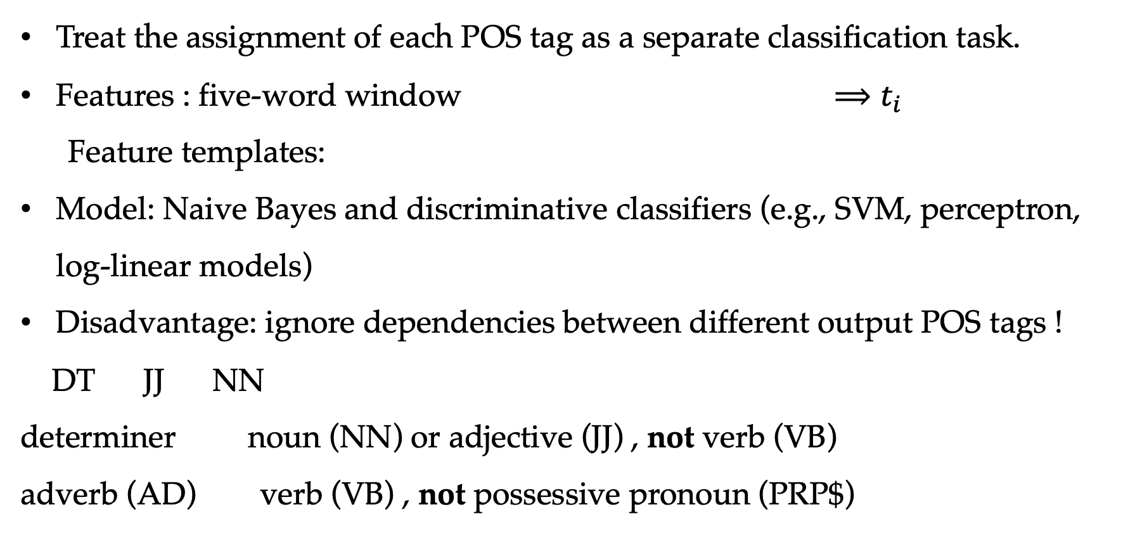
Local Model
Treat the assignment of each POS tag as a separate classification task.
Features : five-word window $⟹t_{i}$
Feature templates:
Model: Naive Bayes and discriminative classifiers (e.g., SVM, perceptron, log-linear models)
Disadvantage: ignore dependencies between different output POS tags !
DT JJ NN
determiner noun (NN) or adjective (JJ) , not verb (VB)
adverb (AD) verb (VB) , not possessive pronoun (PRP$)

Slide 11
Contents
7.1 Structured Prediction and Sequence Labelling
7.2 Hidden Markov Models —— Generative Models
7.2.1 Training Hidden Markov Models
7.2.2 Decoding
7.3 Maximum Entropy Markov Models
7.4 Conditional random fields
7.4.1 Global modeling
7.4.2 Decoding
7.4.3 Training

Slide 12
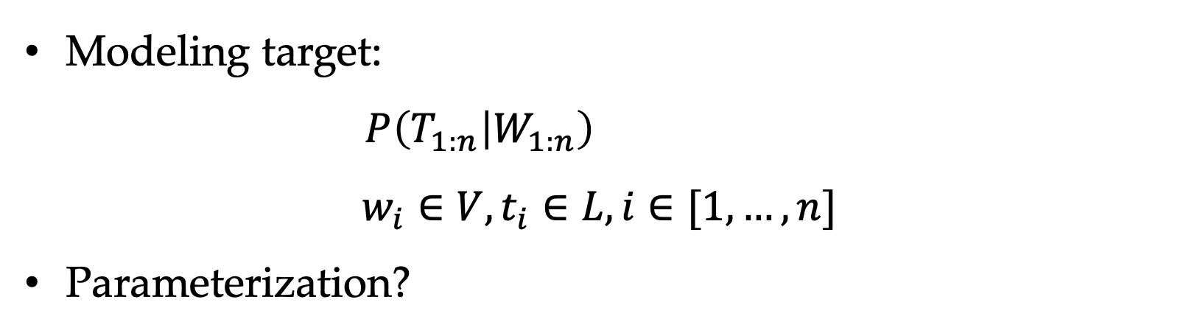
Hidden Markov Models
Modeling target:
$P\left(T_{1:n} | W_{1:n}\right)$
$$w_{i}∈V,t_{i}∈L, i∈[1,…,n]$$
Parameterization?

Slide 13
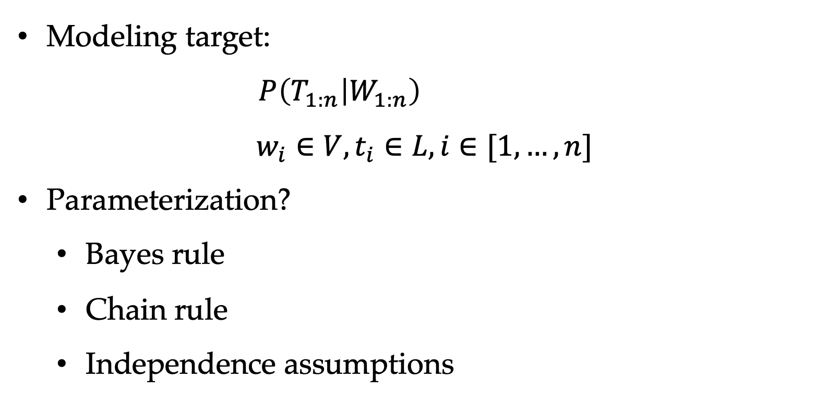
Hidden Markov Models
Modeling target:
$P\left(T_{1:n} | W_{1:n}\right)$
$$w_{i}∈V,t_{i}∈L, i∈[1,…,n]$$
Parameterization?
Bayes rule
Chain rule
Independence assumptions

Slide 14
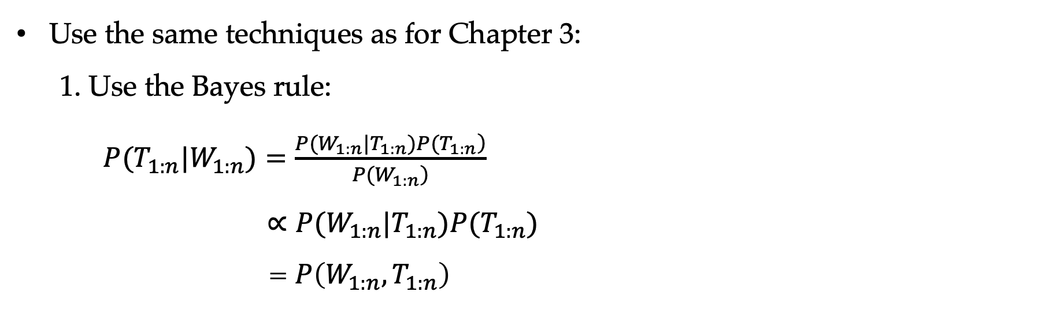
Hidden Markov Models
Use the same techniques as for Chapter 3:
1. Use the Bayes rule:
$P(T_{1:n}|W_{1:n})=\frac{\left.P(W_{1:n}|T_{1:n})P(T_{1:n}\right)}{\left.P(W_{1:n}\right)}$
$∝P(W_{1:n}|T_{1:n})P(T_{1:n})$
= $P\left(W_{1:n},T_{1:n}\right)$

Slide 15
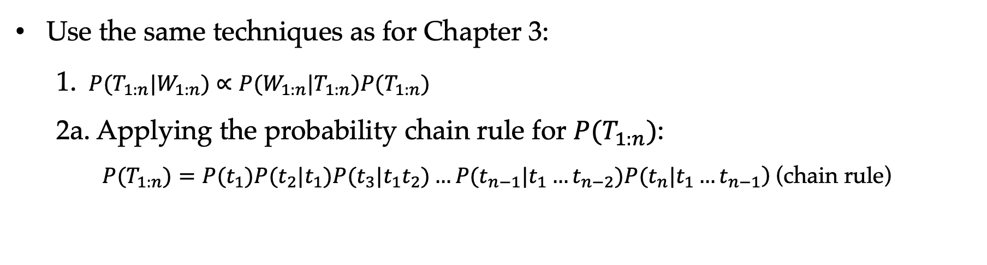
Hidden Markov Models
Use the same techniques as for Chapter 3:
1. $P(T_{1:n}|W_{1:n})∝P(W_{1:n}|T_{1:n})P(T_{1:n})$
2a. Applying the probability chain rule for $P(T_{1:n})$:
$$\left.P(T_{1:n})=P(t_{1})P(t_{2}|t_{1})P(t_{3}|t_{1}t_{2})…P(t_{n−1}|t_{1}…t_{n−2})P(t_{n}|t_{1}…t_{n−1}\right) \text{(}\text{chain} \text{rule}\text{)}$$

Slide 16
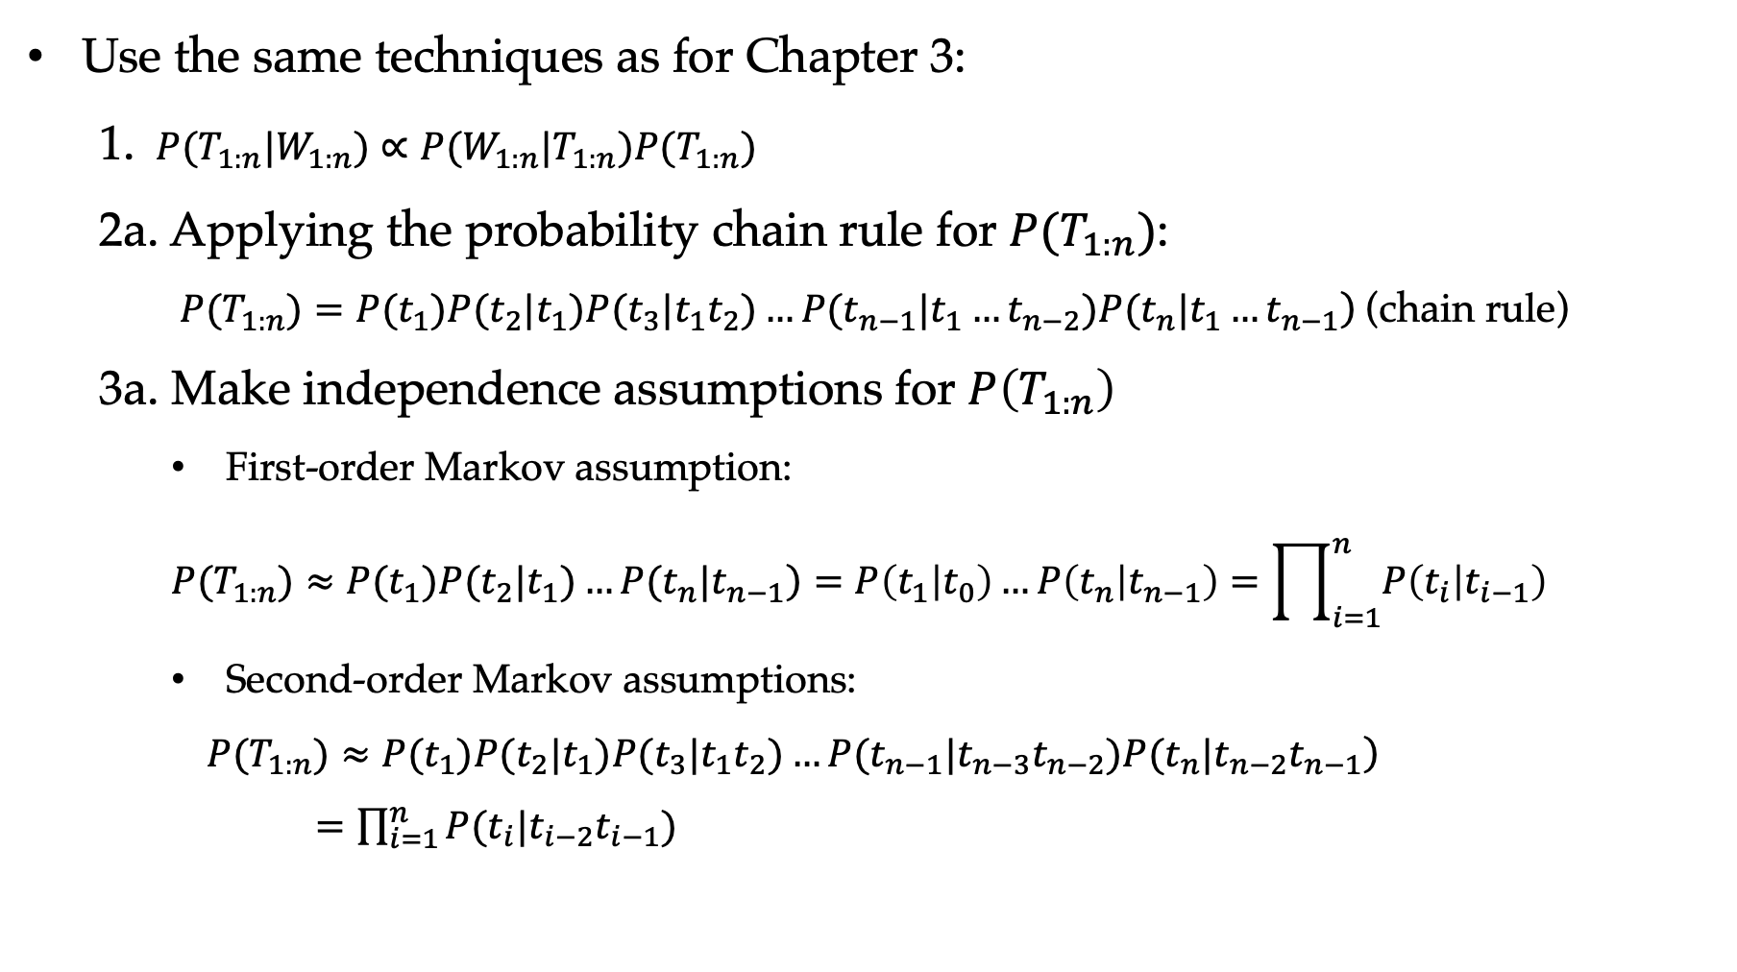
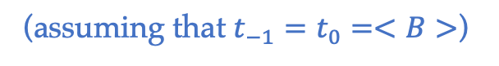
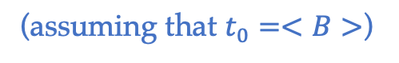
Hidden Markov Models
Use the same techniques as for Chapter 3:
1. $P(T_{1:n}|W_{1:n})∝P(W_{1:n}|T_{1:n})P(T_{1:n})$
2a. Applying the probability chain rule for $P(T_{1:n})$:
$$\left.P(T_{1:n})=P(t_{1})P(t_{2}|t_{1})P(t_{3}|t_{1}t_{2})…P(t_{n−1}|t_{1}…t_{n−2})P(t_{n}|t_{1}…t_{n−1}\right) \text{(}\text{chain} \text{rule}\text{)}$$
3a. Make independence assumptions for $P\left(T_{1:n}\right)$
First-order Markov assumption:
$$\left.P(T_{1:n})≈P(t_{1})P(t_{2}|t_{1})…P(t_{n}|t_{n−1}\right)=P\left(t_{1} | t_{0}\right)…P\left(t_{n} | t_{n−1}\right)=\prod_{i=1}^{n}{P\left(t_{i} | t_{i−1}\right)}$$
Second-order Markov assumptions:
$\left.P(T_{1:n})≈P(t_{1})P(t_{2}|t_{1})P(t_{3}|t_{1}t_{2})…P(t_{n−1}|t_{n−3}t_{n−2})P(t_{n}|t_{n−2}t_{n−1}\right)$
$=\prod_{i=1}^{n}{P(t_{i}|t_{i−2}t_{i−1})}$
(assuming that $t_{0}=<B>$)
(assuming that $t_{−1}=t_{0}=<B>$)

Slide 17
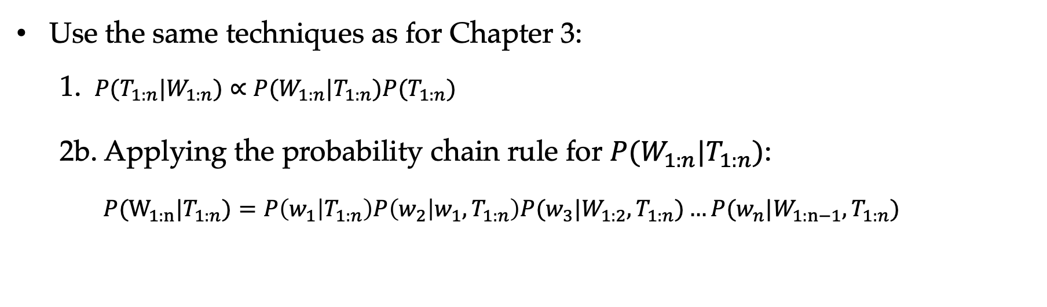
Hidden Markov Models
Use the same techniques as for Chapter 3:
1. $P(T_{1:n}|W_{1:n})∝P(W_{1:n}|T_{1:n})P(T_{1:n})$
2b. Applying the probability chain rule for $P(W_{1:n}|T_{1:n})$:
$P(W_{1:n}|T_{1:n})=P\left(w_{1} | T_{1:n}\right)P\left(w_{2} | w_{1},T_{1:n}\right)P(w_{3}|W_{1:2},T_{1:n})…P(w_{n}|W_{1:n−1}, T_{1:n})$

Slide 18
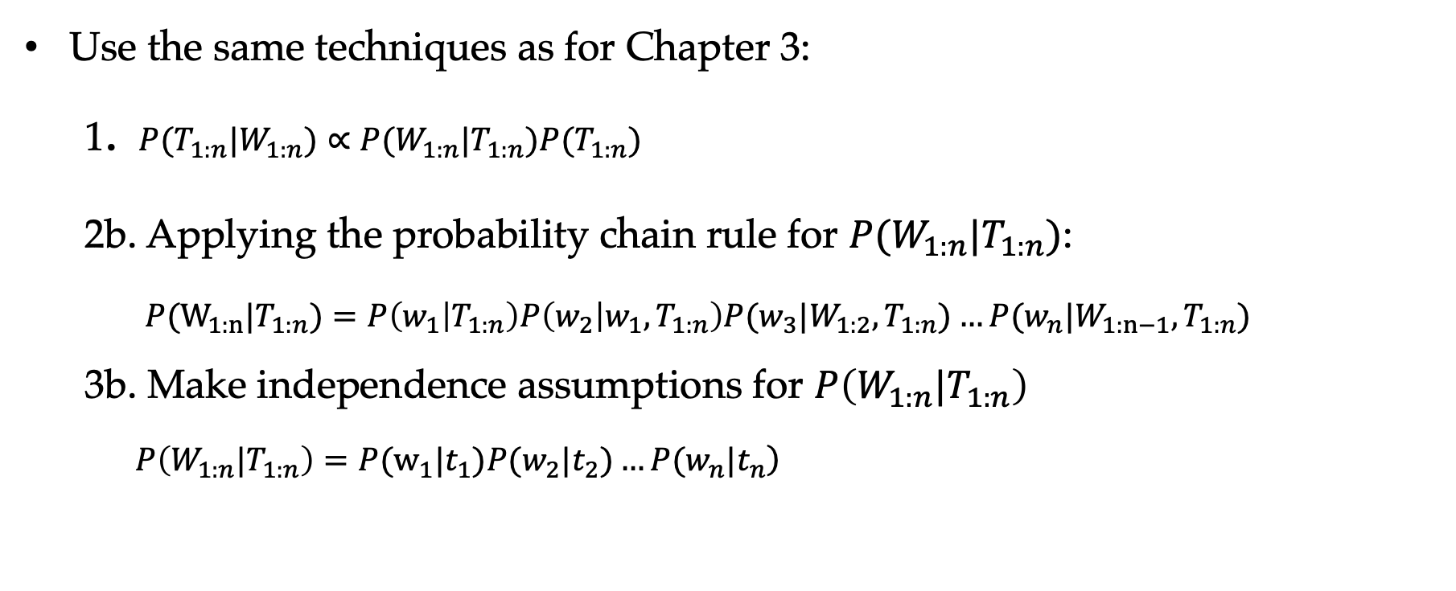
Hidden Markov Models
Use the same techniques as for Chapter 3:
1. $P(T_{1:n}|W_{1:n})∝P(W_{1:n}|T_{1:n})P(T_{1:n})$
2b. Applying the probability chain rule for $P(W_{1:n}|T_{1:n})$:
$P(W_{1:n}|T_{1:n})=P\left(w_{1} | T_{1:n}\right)P\left(w_{2} | w_{1},T_{1:n}\right)P(w_{3}|W_{1:2},T_{1:n})…P(w_{n}|W_{1:n−1}, T_{1:n})$
3b. Make independence assumptions for $P\left(W_{1:n}|T_{1:n}\right)$
$\left.P\left({W_{1:n}|T}_{1:n}\right)=P(w_{1}|t_{1})P(w_{2}|t_{2})…P(w_{n}|t_{n}\right)$

Slide 19
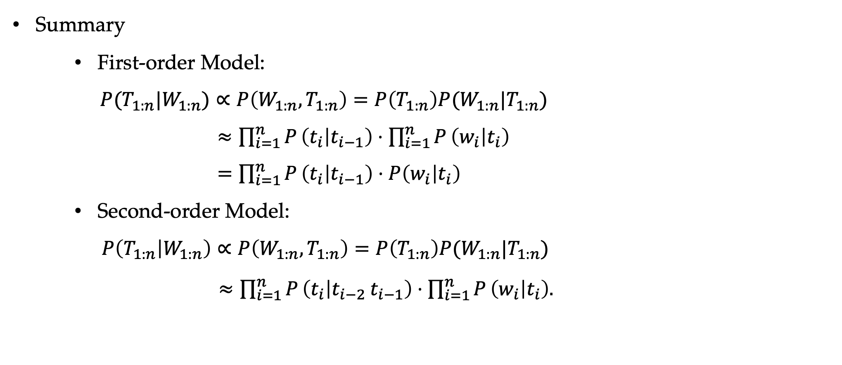
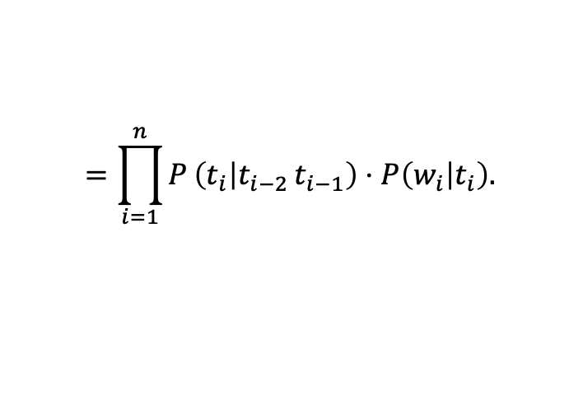
Hidden Markov Models
Summary
First-order Model:
$P(T_{1:n}|W_{1:n})∝P\left(W_{1:n},T_{1:n}\right)=P\left(T_{1:n}\right)P(W_{1:n}|T_{1:n})$
$≈\prod_{i=1}^{n}{P}\left(t_{i} | t_{i−1}\right)⋅\prod_{i=1}^{n}{P}\left(w_{i} | t_{i}\right)$
$=\prod_{i=1}^{n}{P}\left(t_{i} | t_{i−1}\right)⋅P\left(w_{i} | t_{i}\right)$
Second-order Model:
$P\left(T_{1:n} | W_{1:n}\right)∝P\left(W_{1:n},T_{1:n}\right)=P\left(T_{1:n}\right)P(W_{1:n}|T_{1:n})$
$≈\prod_{i=1}^{n}{P}\left(t_{i} | t_{i−2} t_{i−1}\right)⋅\prod_{i=1}^{n}{P}\left(w_{i} | t_{i}\right).$
$$=\prod_{i=1}^{n}{P}\left(t_{i} | t_{i−2} t_{i−1}\right)⋅P\left(w_{i} | t_{i}\right).$$
Notes:
Emission & transition

Slide 20
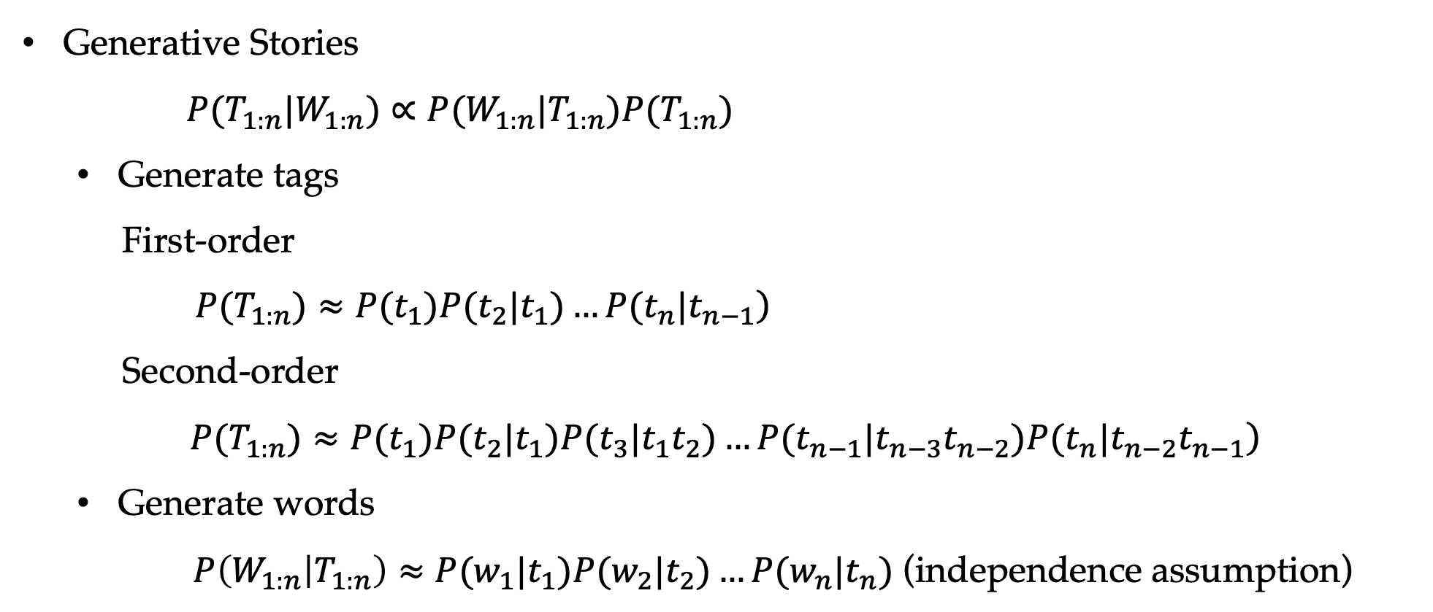
Hidden Markov Models
Generative Stories
$P(T_{1:n}|W_{1:n})∝P(W_{1:n}|T_{1:n})P(T_{1:n})$
Generate tags
First-order
$\left.P(T_{1:n})≈P(t_{1})P(t_{2}|t_{1})…P(t_{n}|t_{n−1}\right)$
Second-order
$$\left. P(T_{1:n})≈P(t_{1})P(t_{2}|t_{1})P(t_{3}|t_{1}t_{2})…P(t_{n−1}|t_{n−3}t_{n−2})P(t_{n}|t_{n−2}t_{n−1}\right)$$
Generate words
$P\left(W_{1:n} | T_{1:n}\right)≈P(w_{1}|t_{1})P(w_{2}|t_{2})…P(w_{n}|t_{n}) \text{(}\text{independence} \text{assumption}\text{)}$
Notes:
Emission & transition

Slide 21
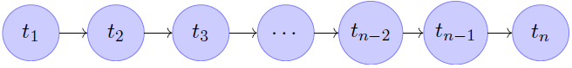
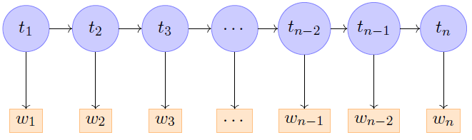
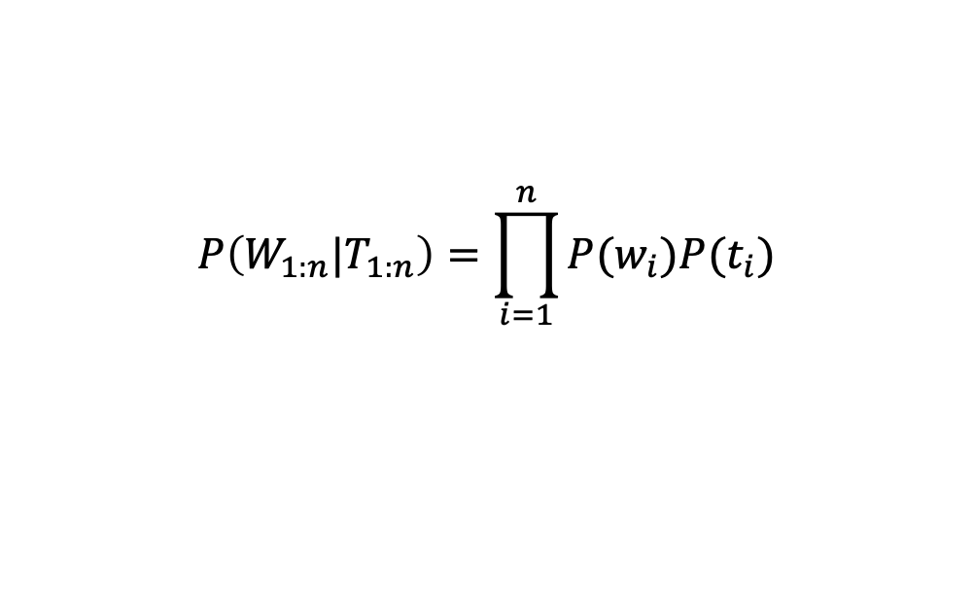
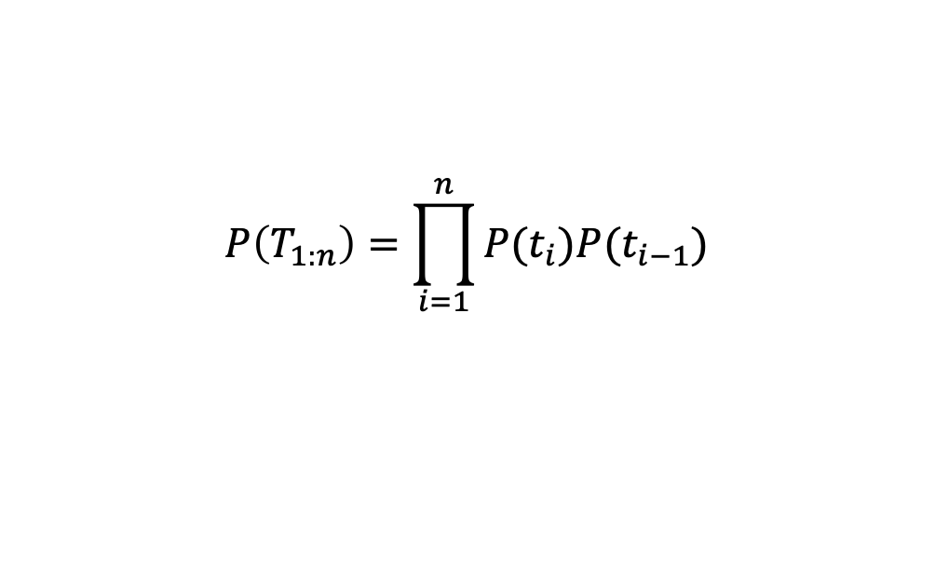
Hidden Markov Models
A generative model.
First generate tags such as “NNP (proper noun) VBZ (verb third-person singular) NN(noun)”
Then filling the words such as “Jim reads thrillers”.
$$P(T_{1:n}|W_{1:n})∝P(W_{1:n}|T_{1:n})P(T_{1:n})$$
$$P\left(T_{1:n}\right)=\prod_{i=1}^{n}{P(t_{i})P(t_{i−1})}$$
$$P\left(W_{1:n}|T_{1:n}\right)=\prod_{i=1}^{n}{P(w_{i})P(t_{i})}$$

Slide 22
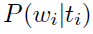
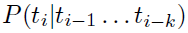
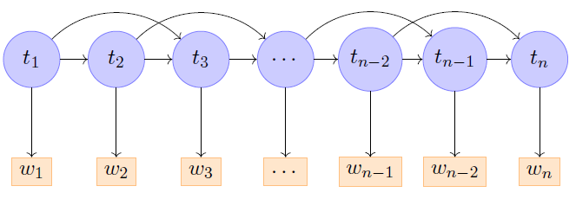
Hidden Markov Models
First-order Model:
Second-order Model:
Emission probability:
Transition probability:

Slide 23
Contents
7.1 Structured Prediction and Sequence Labelling
7.2 Hidden Markov Models —— Generative Models
7.2.1 Training Hidden Markov Models
7.2.2 Decoding
7.3 Maximum Entropy Markov Models
7.4 Conditional random fields
7.4.1 Global modeling
7.4.2 Decoding
7.4.3 Training

Slide 24
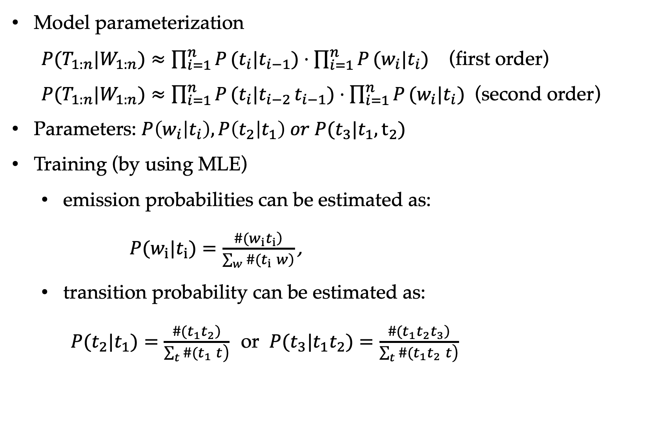
Hidden Markov Models
Model parameterization
$P(T_{1:n}|W_{1:n})≈\prod_{i=1}^{n}{P}(t_{i}|t_{i−1})⋅\prod_{i=1}^{n}{P}(w_{i}|t_{i})$ (first order) $P(T_{1:n}|W_{1:n})≈\prod_{i=1}^{n}{P}(t_{i}|t_{i−2} t_{i−1})⋅\prod_{i=1}^{n}{P}(w_{i}|t_{i})$ (second order)
Parameters: $P\left(w_{i} | t_{i}\right), P\left(t_{2} | t_{1}\right) or P(t_{3}|t_{1},t_{2})$
Training (by using MLE)
emission probabilities can be estimated as:
$P(w_{i}|t_{i})=\frac{\left.\#(w_{i}t_{i}\right)}{\left.\sum_{w}{\#}(t_{i} w\right)}\text{,}$
transition probability can be estimated as:
$P(t_{2}|t_{1})=\frac{\left.\#(t_{1}t_{2}\right)}{\left.\sum_{t}{\#}(t_{1} t\right)}$or $P(t_{3}|t_{1}t_{2})=\frac{\left.\#(t_{1}t_{2}t_{3}\right)}{\left.\sum_{t}{\#}(t_{1}t_{2} t\right)}$
Notes:
Equation error

Slide 25
Contents
7.1 Structured Prediction and Sequence Labelling
7.2 Hidden Markov Models —— Generative Models
7.2.1 Training Hidden Markov Models
7.2.2 Decoding
7.3 Maximum Entropy Markov Models
7.4 Conditional random fields
7.4.1 Global modeling
7.4.2 Decoding
7.4.3 Training

Slide 26
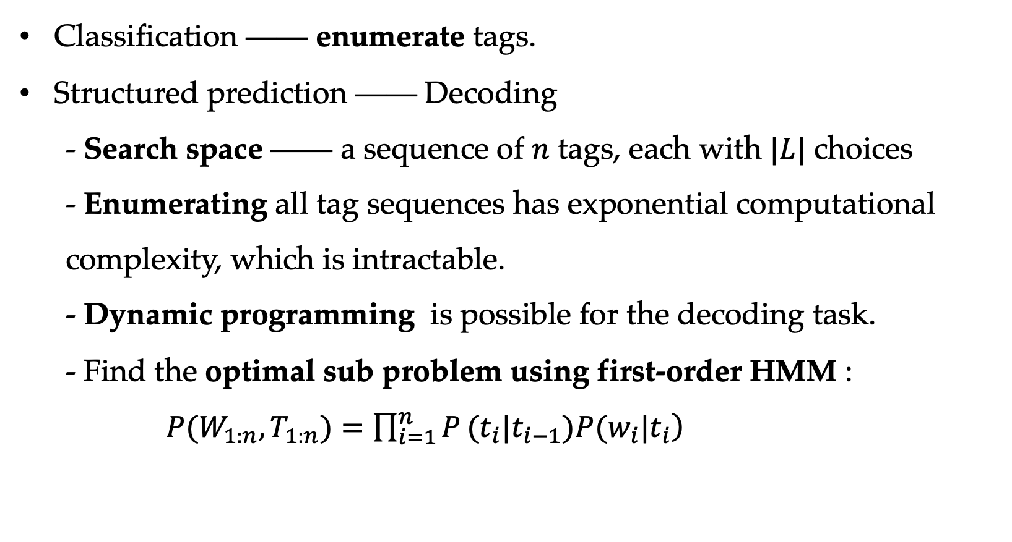
Hidden Markov Models
Classification —— enumerate tags.
Structured prediction —— Decoding
- Search space —— a sequence of $n$ tags, each with $|L|$ choices
- Enumerating all tag sequences has exponential computational complexity, which is intractable.
- Dynamic programming is possible for the decoding task.
- Find the optimal sub problem using first-order HMM :
$\left.P(W_{1:n},T_{1:n})=\prod_{i=1}^{n}{P}(t_{i}|t_{i−1})P(w_{i}|t_{i}\right)$

Slide 27
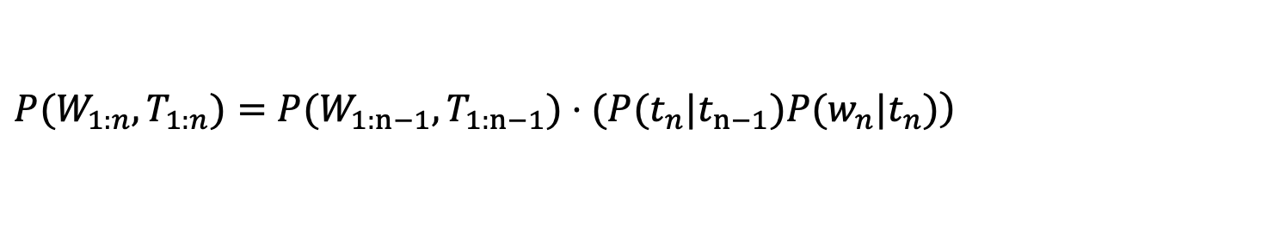
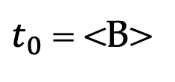
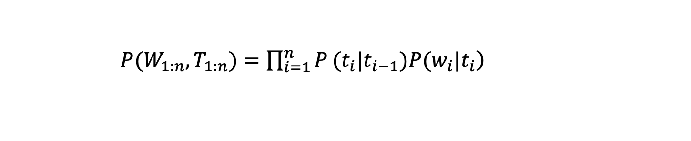
Hidden Markov Models
First-order Model:
$\left.P(W_{1:n},T_{1:n})=\prod_{i=1}^{n}{P}(t_{i}|t_{i−1})P(w_{i}|t_{i}\right)$
$\left.P(W_{1:n},T_{1:n})=P(W_{1:n−1},T_{1:n−1})⋅(P(t_{n}|t_{n−1})P(w_{n}|t_{n})\right)$
$t_{0}$ = <B>
sepcial label

Slide 28
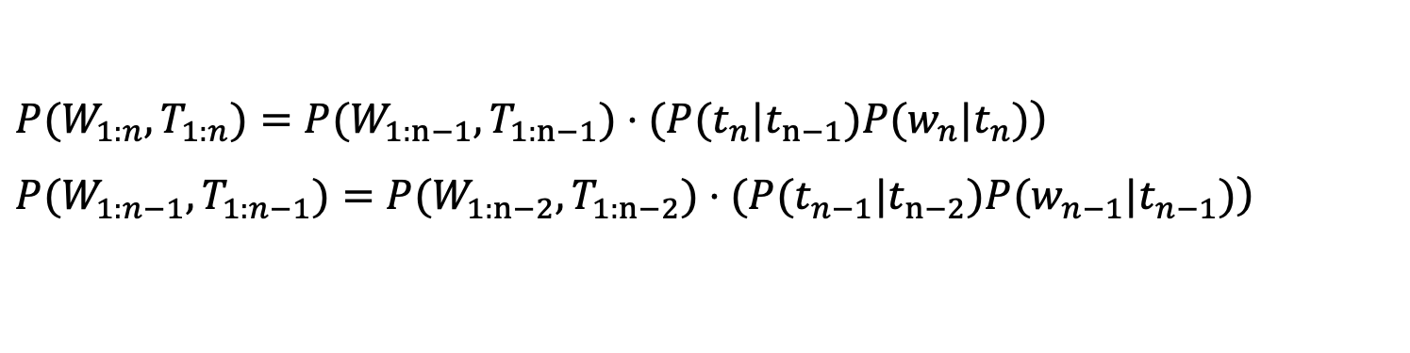
Hidden Markov Models
First-order Model:
$\left.P(W_{1:n},T_{1:n})=\prod_{i=1}^{n}{P}(t_{i}|t_{i−1})P(w_{i}|t_{i}\right)$
$\left.P(W_{1:n},T_{1:n})=P(W_{1:n−1},T_{1:n−1})⋅(P(t_{n}|t_{n−1})P(w_{n}|t_{n})\right)$
$\left.P(W_{1:n−1},T_{1:n−1})=P(W_{1:n−2},T_{1:n−2})⋅(P(t_{n−1}|t_{n−2})P(w_{n−1}|t_{n−1})\right)$
$t_{0}$ = <B>
sepcial label

Slide 29
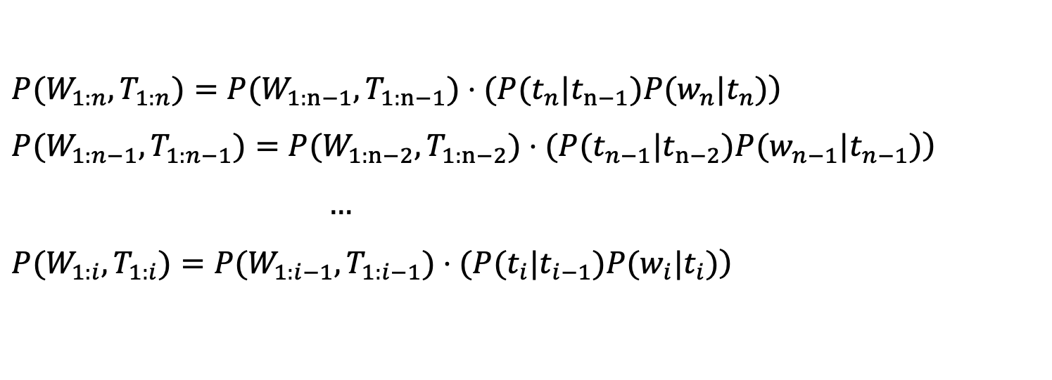
Hidden Markov Models
First-order Model:
$\left.P(W_{1:n},T_{1:n})=\prod_{i=1}^{n}{P}(t_{i}|t_{i−1})P(w_{i}|t_{i}\right)$
$\left.P(W_{1:n},T_{1:n})=P(W_{1:n−1},T_{1:n−1})⋅(P(t_{n}|t_{n−1})P(w_{n}|t_{n})\right)$
$\left.P(W_{1:n−1},T_{1:n−1})=P(W_{1:n−2},T_{1:n−2})⋅(P(t_{n−1}|t_{n−2})P(w_{n−1}|t_{n−1})\right)$
$…$
$\left.P(W_{1:i},T_{1:i})=P(W_{1:i−1},T_{1:i−1})⋅(P(t_{i}|t_{i−1})P(w_{i}|t_{i})\right)$
$t_{0}$ = <B>
special label

Slide 30
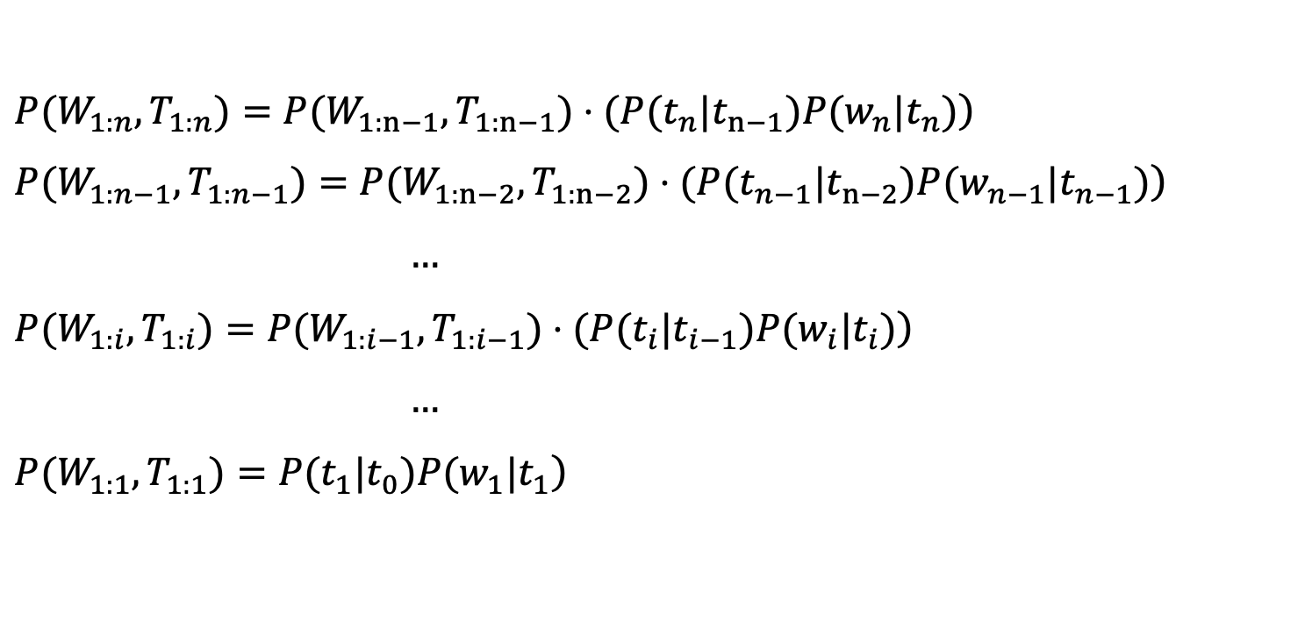
Hidden Markov Models
First-order Model:
$\left.P(W_{1:n},T_{1:n})=\prod_{i=1}^{n}{P}(t_{i}|t_{i−1})P(w_{i}|t_{i}\right)$
$\left.P(W_{1:n},T_{1:n})=P(W_{1:n−1},T_{1:n−1})⋅(P(t_{n}|t_{n−1})P(w_{n}|t_{n})\right)$
$\left.P(W_{1:n−1},T_{1:n−1})=P(W_{1:n−2},T_{1:n−2})⋅(P(t_{n−1}|t_{n−2})P(w_{n−1}|t_{n−1})\right)$
$…$
$\left.P(W_{1:i},T_{1:i})=P(W_{1:i−1},T_{1:i−1})⋅(P(t_{i}|t_{i−1})P(w_{i}|t_{i})\right)$
$…$
$\left.P(W_{1:1},T_{1:1})=P(t_{1}|t_{0})P(w_{1}|t_{1}\right)$
$t_{0}$ = <B>
special label

Slide 31
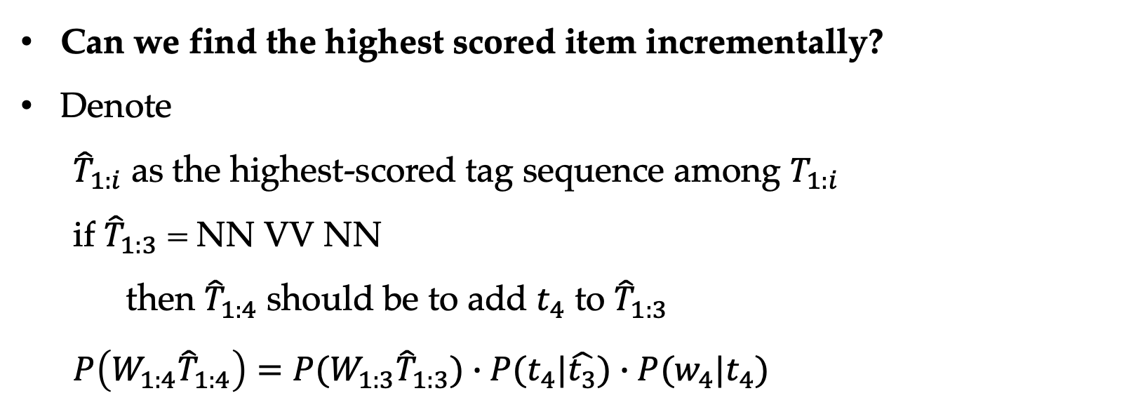
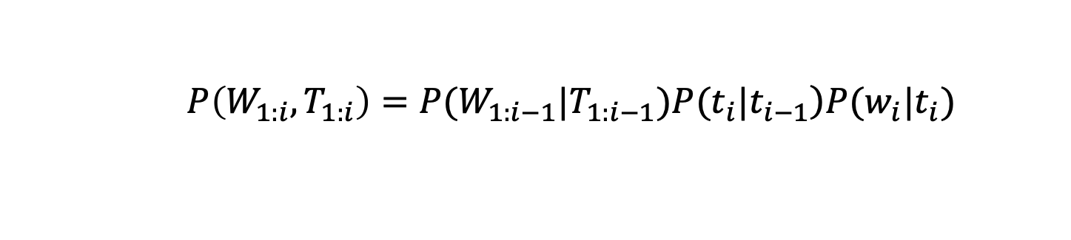
Hidden Markov Models
$\left.P\left(W_{1:i},T_{1:i}\right)=P(W_{1:i−1}|T_{1:i−1})P(t_{i}|t_{i−1}\right)P(w_{i}|t_{i})$
Can we find the highest scored item incrementally?
Denote
${\hat{T}}_{1:i}$ as the highest-scored tag sequence among $T_{1:i}$
if ${\hat{T}}_{1:3}$ = NN VV NN
then ${\hat{T}}_{1:4}$ should be to add $t_{4}$ to ${\hat{T}}_{1:3}$
$P\left({W_{1:4}\hat{T}}_{1:4}\right)=P(W_{1:3}{\hat{T}}_{1:3})∙P(t_{4}|\hat{t_{3}})∙P(w_{4}|t_{4})$

Slide 32
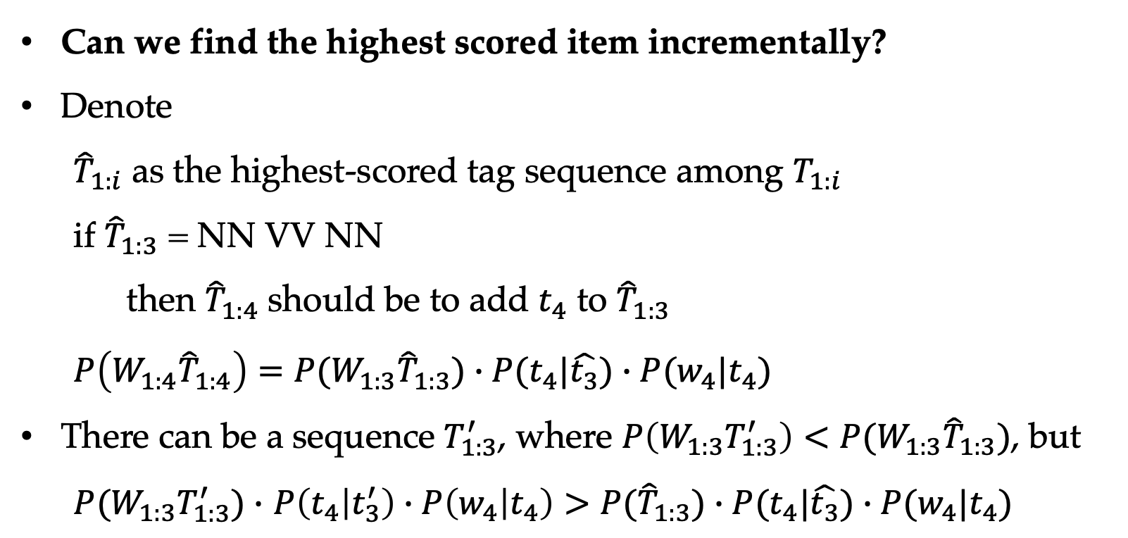
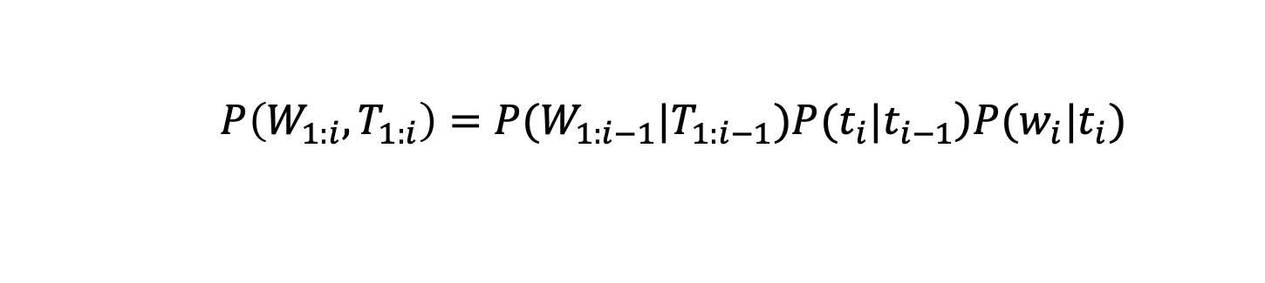
Hidden Markov Models
$\left.P\left(W_{1:i},T_{1:i}\right)=P(W_{1:i−1}|T_{1:i−1})P(t_{i}|t_{i−1}\right)P(w_{i}|t_{i})$
Can we find the highest scored item incrementally?
Denote
${\hat{T}}_{1:i}$ as the highest-scored tag sequence among $T_{1:i}$
if ${\hat{T}}_{1:3}$ = NN VV NN
then ${\hat{T}}_{1:4}$ should be to add $t_{4}$ to ${\hat{T}}_{1:3}$
$P\left(W_{1:4}{\hat{T}}_{1:4}\right)=P(W_{1:3}{\hat{T}}_{1:3})∙P(t_{4}|\hat{t_{3}})∙P(w_{4}|t_{4})$
There can be a sequence $T_{1:3}^{′}$, where $P\left(W_{1:3}T_{1:3}^{′}\right)<$ $P(W_{1:3}{\hat{T}}_{1:3})$, but
$P(W_{1:3}T_{1:3}^{′})∙$ $P\left(t_{4} | t_{3}^{′}\right)∙P\left(w_{4} | t_{4}\right)>P({\hat{T}}_{1:3})∙P(t_{4}|\hat{t_{3}})∙P(w_{4}|t_{4})$

Slide 33
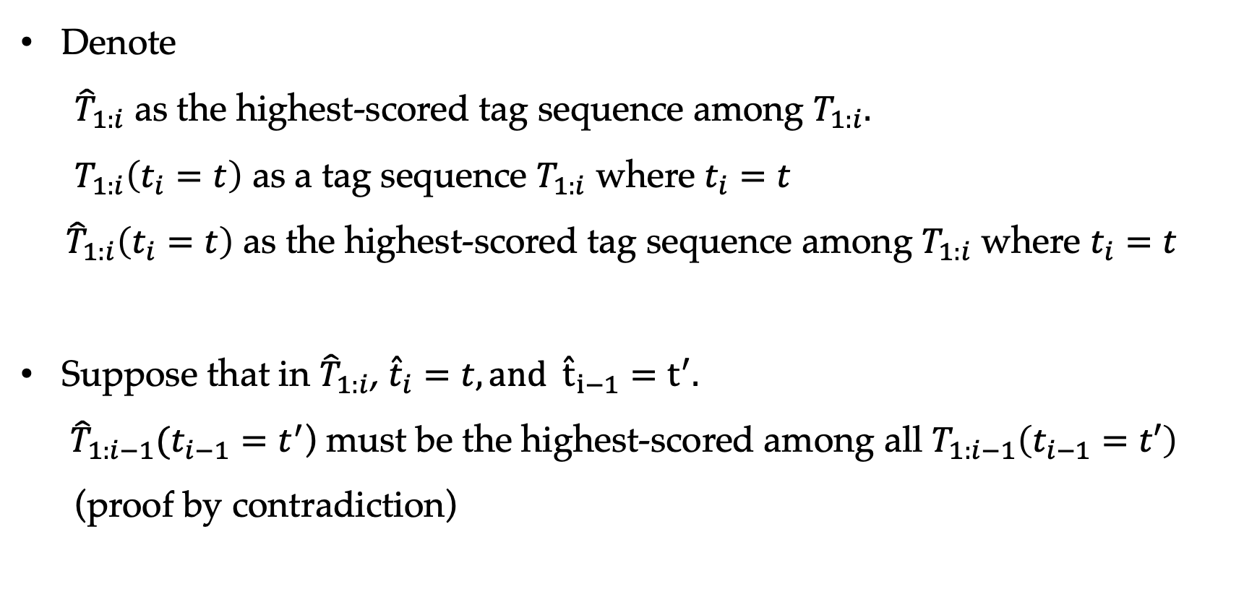
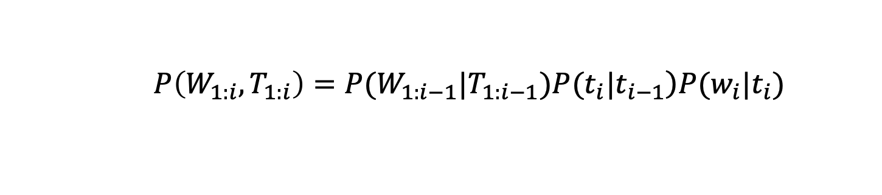
Hidden Markov Models
$\left.P\left(W_{1:i},T_{1:i}\right)=P(W_{1:i−1}|T_{1:i−1})P(t_{i}|t_{i−1}\right)P(w_{i}|t_{i})$
Denote
${\hat{T}}_{1:i}$ as the highest-scored tag sequence among $T_{1:i}.$ $T_{1:i}\left(t_{i}=t\right)$ as a tag sequence $T_{1:i}$ where $t_{i}=t$
${\hat{T}}_{1:i}\left(t_{i}=t\right)$ as the highest-scored tag sequence among $T_{1:i}$ where $t_{i}=t$
Suppose that in ${\hat{T}}_{1:i}$, ${\hat{t}}_{i}=t, and {\hat{t}}_{i−1}=t^{′}.$
${\hat{T}}_{1:i−1}(t_{i−1}=t^{′}$) must be the highest-scored among all $T_{1:i−1}\left(t_{i−1}=t′\right)$ (proof by contradiction)

Slide 34
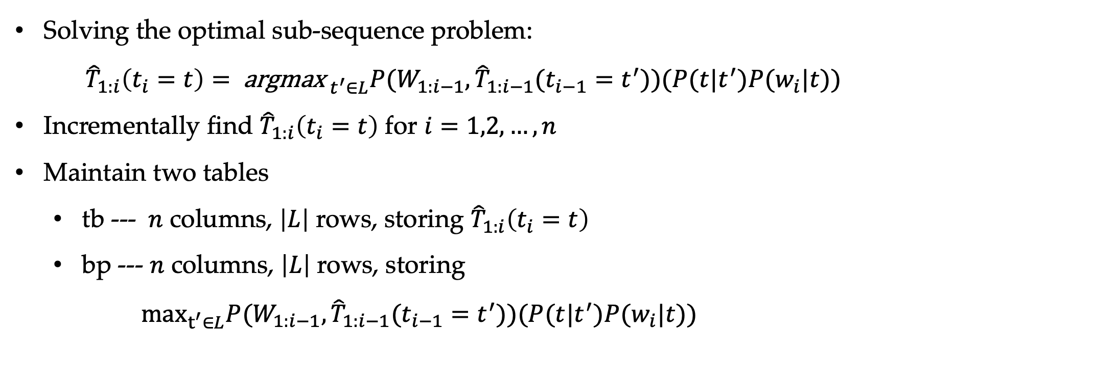
Hidden Markov Models
$\left.P\left(W_{1:i},T_{1:i}\right)=P(W_{1:i−1}|T_{1:i−1})P(t_{i}|t_{i−1}\right)P(w_{i}|t_{i})$
Solving the optimal sub-sequence problem:
${\hat{T}}_{1:i}\left(t_{i}=t\right)={ \text{argmax}}_{ t^{′}∈L}P(W_{1:i−1},{\hat{T}}_{1:i−1}(t_{i−1}=t^{′}))(P(t|t^{′})P(w_{i}|t))$
Incrementally find ${\hat{T}}_{1:i}\left(t_{i}=t\right)$ for $i=1,2,…,n$
Maintain two tables
tb --- $n$ columns, $\left|L\right|$ rows, storing ${\hat{T}}_{1:i}\left(t_{i}=t\right)$
bp --- $n$ columns, $\left|L\right|$ rows, storing
$\max_{t^{′}∈L}P(W_{1:i−1},{\hat{T}}_{1:i−1}(t_{i−1}=t^{′}))(P(t|t^{′})P(w_{i}|t))$

Slide 35
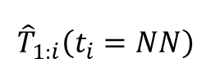
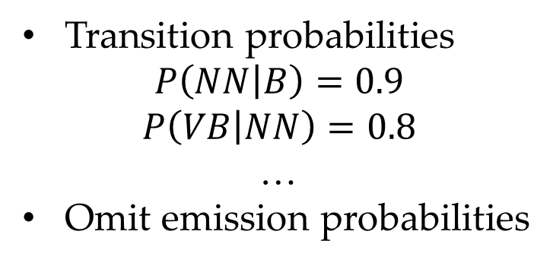

Hidden Markov Models
An example (adding <B> in the beginning)
Find the path with the highest probability.
People like books
tb table
bp table
NN
0.2
NN
0.2
NN
$${\hat{T}}_{1:i}\left(t_{i}=NN\right)$$
0 | 0 | 0
0 | 0 | 0
0.9
0.8
0.8
B
$${\hat{T}}_{1:i}\left(t_{i}=VB\right)$$
0.6
0.6
0.1
VB
VB
VB
1 2 3
0.4
0.4
Transition probabilities
$$P\left(NN | B\right)=0.9$$
$$P\left(VB | NN\right)=0.8$$
…
Omit emission probabilities

Slide 36


Hidden Markov Models
An example (adding <B> in the beginning)
Find the path with the highest probability.
People like books
tb table
bp table
NN
0.2
NN
0.2
NN
0 | 0 | 0
0 | 0 | 0
0.9
0.8
0.8
B
0.1
VB
0.6
VB
0.6
VB
0.4
0.4
0.9 | 0 | 0
0.1 | 0 | 0
B
B
${\hat{T}}_{1:1}\left(t_{1}=NN\right)$=0.9
${\hat{T}}_{1:1}\left(t_{1}=VB\right)$=0.1

Slide 37




Hidden Markov Models
An example (adding <B> in the beginning)
Find the path with the highest probability.
People like books
tb table
bp table
NN
0.2
NN
0.2
NN
0 | 0 | 0
0 | 0 | 0
0.9
0.8
0.8
B
0.1
VB
0.6
VB
0.6
VB
0.4
0.4
0.9 | 0 | 0
0.1 | 0 | 0
B
B
$$t_{2}=NN$$
$$0.9×0.2 vs 0.1×0.6$$
0.9 | 0.9*0.2 0.1*0.6 | 0
0.1 | 0.9*0.8 0.1*0.4 | 0
B | NN
B | NN
$$t_{2}=VB$$
$$0.9×0.8 vs 0.1×0.4$$
${\hat{T}}_{1:2}\left(t_{2}=NN\right)$=0.9*0.2=0.18 (NN NN > VB NN)
${\hat{T}}_{1:2}\left(t_{2}=VB\right)$=0.9*0.8=0.72 (NN VB > VB VB)

Slide 38




Hidden Markov Models
An example (adding <B> in the beginning)
Find the path with the highest probability.
People like books
tb table
bp table
NN
0.2
NN
0.2
NN
0 | 0 | 0
0 | 0 | 0
0.9
0.8
0.8
B
0.1
VB
0.6
VB
0.6
VB
0.4
0.4
0.9 | 0 | 0
0.1 | 0 | 0
B
VB
$$t_{2}=NN$$
$$0.18×0.2 vs 0.72×0.6$$
0.9 | 0.9*0.2 0.1*0.6 | 0
0.1 | 0.9*0.8 0.1*0.4 | 0
B | NN
B | NN
$$t_{2}=VB$$
$$0.18×0.8 vs 0.72×0.4$$
0.9 | 0.18 | 0.18*0.2 0.72*0.6
0.1 | 0.72 | 0.18*0.8 0.72*0.4
B | NN | VB
B | NN | VB
(NN NN NN < NN VB NN) (NN NN VB < NN VB VB)

Slide 39
Hidden Markov Models
An example (adding <B> in the beginning)
Find the path with the highest probability.
tb table
bp table
0 | 0 | 0
0 | 0 | 0
People like books
NN
0.2
NN
0.2
NN
0.9
0.8
0.8
B
0.9 | 0 | 0
0.1 | 0 | 0
B
B
0.1
VB
0.6
VB
0.6
VB
0.4
0.4
0.9 | 0.9*0.2 0.1*0.6 | 0
0.1 | 0.9*0.8 0.1*0.4 | 0
B | NN
B | NN
0.9 | 0.18 | 0.18*0.2 0.72*0.6
0.1 | 0.72 | 0.18*0.8 0.72*0.4
B | NN | VB
B | NN | VB
0.9 | 0.18 | 0.432
0.1 | 0.72 | 0.288
B | NN | VB
B | NN | VB
(NN VB NN > NN VB VB)

Slide 40
Hidden Markov Models
An example (adding <B> in the beginning)
Find the path with the highest probability.
tb table
bp table
0 | 0 | 0
0 | 0 | 0
People like books
NN
0.2
NN
0.2
NN
0.9
0.8
0.8
B
0.9 | 0 | 0
0.1 | 0 | 0
B
B
0.1
VB
0.6
VB
0.6
VB
0.4
0.4
0.9 | 0.9*0.2 0.1*0.6 | 0
0.1 | 0.9*0.8 0.1*0.4 | 0
B | NN
B | NN
People like books
0.9 | 0.18 | 0.18*0.2 0.72*0.6
0.1 | 0.72 | 0.18*0.8 0.72*0.4
B | NN | VB
B | NN | VB
NN
0.2
NN
0.2
NN
0.9
0.8
0.8
B
B | NN | VB
B | NN | VB
0.1
VB
0.6
VB
0.6
VB
0.9 | 0.18 | 0.432
0.1 | 0.72 | 0.288
0.4
0.4

Slide 41

Hidden Markov Models
Time：
O(${|L|}^{n}$) → O($n{|L|}^{2}$)
Space (two 𝐿∗𝑛 tables):
tb: the probability table
bp: the “back pointer”
Algorithms
-- building table (Viterbi)
-- finding tag sequence (back tracking)

Slide 42
Contents
7.1 Structured Prediction and Sequence Labelling
7.2 Hidden Markov Models —— Generative Models
7.2.1 Training Hidden Markov Models
7.2.2 Decoding
7.3 Maximum Entropy Markov Models
7.4 Conditional random fields
7.4.1 Global modeling
7.4.2 Decoding
7.4.3 Training

Slide 43

Discriminative Model
Generative Model
Estimate joint probabilities $P\left(T_{1:n},W_{1:n}\right)$
Examples: HMM
Discriminative Model
Calculates $P\left(T_{1:n} | W_{1:n}\right)$ directly
Examples: MEMM, CRF
Advantage: rich features

Slide 44

Local Trained Discriminative Model
A local model models each $t_{i}$ separately.
Simplify $P(T_{1:n}|W_{1:n})$ before parameterization using features.
Factorize the sequence level probability by chain rule: $P\left(T_{1:n} | W_{1:n}\right)=\prod_{i=1}^{n}{P\left(t_{i} | T_{1:i−1},W_{1:n}\right)}≈\prod_{i=1}^{n}{P\left(t_{i} | T_{i−k:i−1},W_{1:n}\right)}$
Modeling target$P\left(t_{i} | T_{i−k:i−1},W_{1:n}\right)$
Notes:
Equation bug

Slide 45

Local Trained Discriminative Model
A log-linear model (maximum entropy Markov model (MEMM)):
$$P\left(t_{i}=t | T_{i−k:i−1},W_{1:n}\right)=softmax(\vec{θ}⋅\vec{φ}\left(t_{i}=t,T_{i−1:i−1},W_{1:n}\right))$$
$$=\frac{\exp{(\vec{θ}⋅\vec{φ}\left(t_{i}=t,T_{i−k:i−1},W_{1:n}\right))}}{\sum_{t^{′}∈L}{exp\left(\vec{θ}⋅\vec{ϕ}\left(t_{i}=t′,T_{i−k:i−1},W_{1:n}\right)\right)}}$$
$\vec{φ}$denotes the feature vector
$L$ denotes the set of all possible labels
$\vec{θ}$denotes the parameter vector
Notes:
Equation bug

Slide 46


An Example of Feature Templates
Note overlapping feature $w_{i}, f(w_{i})$.
Example
- Input: The man went to the park .
- Feature vector for labelling the word "park“ with "NN":
$\vec{φ}\left(t_{6}=NN,t_{5},W_{1:n}\right)$ = <0,0,…,0,1,,0,…,0,1(park|NN),0(park|VV),…,0,1,0,…,0,1,0>

Slide 47













Training
$$w_{1}$$
$$w_{2}$$
$$⋯$$
$$w_{i}$$
$$⋯$$
$$w_{n}$$
Local model
$P\left(t_{i}=t | T_{i−k:i−1},W_{1:n}\right)=\frac{\exp{(\vec{θ}⋅\vec{φ}\left(t_{i}=t,T_{i−k:i−1},W_{1:n}\right))}}{\sum_{t^{′}∈L}{exp\left(\vec{θ}⋅\vec{ϕ}\left(t_{i}=t′,T_{i−k:i−1},W_{1:n}\right)\right)}}$
Objective
maximum log-likelihood of individual $\left(t_{i},T_{i−k:i−1},W_{1:n}\right)$pairs
Optimization method
Stochastic gradient descent (SGD).
$$t_{1}$$
$$t_{2}$$
$$⋯$$
$$t_{i−1}$$
$$t_{i}$$
$$⋯$$
$$t_{n}$$

Slide 48

Decoding objective
$$w_{1}$$
$$w_{2}$$
$$⋯$$
$$w_{i}$$
$$⋯$$
$$w_{n}$$
Global search —— find the highest score:
${ \hat{T}}_{1:n} =argmax_{T_{1:n}}P_{ }\left(T_{1:n} | W_{1:n}\right)$
$=argmax_{T_{1:n}}\prod_{i=1}^{n}{P\left(t_{i} | T_{i−k:i−1},W_{1:n}\right)}$
find ${\hat{T}}_{1:n}$from $L^{n}$ candidate sequences
With same Markov assumption, one can leverage the same dynamic programming principle as HMM decoding
$$t_{1}$$
$$t_{2}$$
$$⋯$$
$$t_{i−1}$$
$$t_{i}$$
$$⋯$$
$$t_{n}$$
Notes:
Latest version of equation

Slide 49

Decoding objective
$$w_{1}$$
$$w_{2}$$
$$⋯$$
$$w_{i}$$
$$⋯$$
$$w_{n}$$
Viterbi Algorithm
Markov assumption (e.g., k=1)
$P\left(T_{1:i} | W_{1:n}\right)=P(T_{1:i−1}|W_{1:n})∙P(t_{i}|t_{i−1},W_{1:n})$
Dynamic programming
Denote $T_{1:i}\left(t_{i}=t\right)$ as a tag sequence with the last tag being $t .$
${\hat{T}}_{1:i}\left(t_{i}=t\right)$ as the highest scored sequence among $T_{1:i}\left(t_{i}=t\right)$.
Then ${\hat{T}}_{1:i}\left(t_{i}=t, t_{i−1}=t′\right)$ must contain ${\hat{T}}_{1:i}\left(t_{i−1}=t′\right)$
Thus $P \left({\hat{T}}_{1:i}\left(t_{i}=t\right)|W_{1:n}\right)$
$=argmax_{t^{′}∈L}P\left({\hat{T}}_{1:i}\left(t_{i}=t, t_{i−1}=t^{′}\right)|W_{1:n}\right)$
$$=argmax_{t^{′}∈L}P\left({\hat{T}}_{1:i−1}\left(t_{i−1}=t^{′}\right) | W_{1:n}\right)∙P(t_{i}|t_{i−1 },W_{1:n})$$
$$t_{1}$$
$$t_{2}$$
$$⋯$$
$$t_{i−1}$$
$$t_{i}$$
$$⋯$$
$$t_{n}$$

Slide 50










Decoding —— Viterbi algorithm
$$tb→P({\hat{T}}_{1:i}(t_{i}=t)|W_{1:n})$$
$$t\backslash i$$
$$NN$$
1 | 2 | 3 | 4 | 5 | 6 | 7
$${\hat{T}}_{1:1}\left(t_{1}=NN\right)$$ | $${\hat{T}}_{1:2}\left(t_{2}=NN\right)$$ | … | $${\hat{T}}_{1:i−1}\left(t_{i−1}=NN\right)$$ | $${\hat{T}}_{1:i}\left(t_{i}=NN\right)$$ | … | $${\hat{T}}_{1:n}\left(t_{n}=NN\right)$$
$${\hat{T}}_{1:1}\left(t_{1}=VV\right)$$ | $${\hat{T}}_{1:2}\left(t_{2}=VV\right)$$ | … | $${\hat{T}}_{1:i−1}\left(t_{i−1}=VV\right)$$ | $${\hat{T}}_{1:i}\left(t_{i}=VV\right)$$ | … | $${\hat{T}}_{1:n}\left(t_{n}=VV\right)$$
. . . | . . . | . . . | . . . | . . . | . . . | . . .
$${\hat{T}}_{1:1}\left(t_{1}=AD\right)$$ | $${\hat{T}}_{1:2}\left(t_{2}=AD\right)$$ | … | $${\hat{T}}_{1:i−1}\left(t_{i−1}=AD\right)$$ | $${\hat{T}}_{1:i}\left(t_{i}=AD\right)$$ | … | $${\hat{T}}_{1:n}\left(t_{n}=AD\right)$$
⃝
$$VV$$
$$1$$
⃝
$$2$$
.
.
.
⃝
$$L$$
$$AD$$
$P\left({\hat{T}}_{1:i}\left(t_{i}=t\right) | W_{1:n}\right)=argmax_{t^{′}∈L}P\left({\hat{T}}_{1:i−1}\left(t_{i−1}=t^{′}\right) | W_{1:n}\right)∙P(t_{i}|t_{i−1},W_{1:n})$
$bp$ stores the argmax, $|L|×n$

Slide 51

The Label Bias Problem
$$w_{1}$$
$$w_{2}$$
$$w_{i}$$
$$w_{n}$$
MEMM is locally trained (or normalized)
factorized by
$P\left(t_{i} | T_{i−k:i−1},W_{1:n}\right)=\frac{\exp{(\vec{θ}⋅\vec{φ}\left(t_{i}=t,T_{i−k:i−1},W_{1:n}\right))}}{\sum_{t^{′}∈L}{exp\left(\vec{θ}⋅\vec{ϕ}\left(t_{i}=t′,T_{i−k:i−1},W_{1:n}\right)\right)}}$
only consider individual label contexts
However, the global probability $P\left(T_{1:n} | W_{1:n}\right)$ is calculated during testing
lead to incorrect estimations of label sequence probabilities
Label Bias –when one specific label prefers a certain label as its successor, then the output sequence tends to have the label pair.
$$⋯$$
$$⋯$$
$$t_{1}$$
$$t_{2}$$
$$⋯$$
$$t_{i−1}$$
$$t_{i}$$
$$⋯$$
$$t_{n}$$

Slide 52


The Label Bias Problem
Suppose that our label set contains only four labels:
L = {<B>,$l_{1}, l_{2},l_{3}$},
Calculate the probabilities of $d_{4}$ and $d_{6}$.

Slide 53

The Label Bias Problem
Direct MLE
$P\left(d_{4}\right)=P\left(l_{1}l_{3}l_{1}\right)=\frac{2}{6} P\left(d_{6}\right)=P\left(l_{1}l_{2}l_{2}\right)=\frac{1}{6}$

Slide 54


The Label Bias Problem
Direct MLE
$P\left(d_{4}\right)=P\left(l_{1}l_{3}l_{1}\right)=\frac{2}{6} P\left(d_{6}\right)=P\left(l_{1}l_{2}l_{2}\right)=\frac{1}{6}$
Estimation by local model

Slide 55

Example of Label Bias
Where is the problem?
$l_{2}$ is only followed by $l_{2}.$ But $l_{3}$ is also followed by $l_{3}$. Although $count\left(l_{2}→l_{2}\right)=1$, $count\left(l_{3}→l_{1}\right)=2$,
$P\left(l_{2}→l_{2}\right)=1$ is overestimated due to local normalization

Slide 56
Example of Label Bias
Where is the problem?
$l_{2}$ is only followed by $l_{2}.$ But $l_{3}$ is also followed by $l_{3}$. Although $count\left(l_{2}→l_{2}\right)=1$, $count\left(l_{3}→l_{1}\right)=2$,
$P\left(l_{2}→l_{2}\right)=1$ is overestimated due to local normalization
Also true for n-gram LMs?

Slide 57
Example of Label Bias
Solution
take full sequences of labels as single units
calculating statistics (e.g., counting features) over full sequences of inputs and outputs before doing model normalization

Slide 58
Contents
7.1 Structured Prediction and Sequence Labelling
7.2 Hidden Markov Models —— Generative Models
7.2.1 Training Hidden Markov Models
7.2.2 Decoding
7.3 Maximum Entropy Markov Models
7.4 Conditional random fields
7.4.1 Global modeling
7.4.2 Decoding
7.4.3 Training

Slide 59







Conditional Random Fields
$$w_{1}$$
$$w_{2}$$
$$⋯$$
$$w_{i}$$
$$⋯$$
$$w_{n}$$
A form of log-linear models for sequence labelling
MEMM is locally normalized
$P\left(t_{i} | T_{i−k:i−1},W_{1:n}\right)=softmax (label score)$
Globally normalized into a sequence distribution
$P\left(T_{1:n} | W_{1:n}\right)=softmax (label sequence score)$
Global score $\vec{θ}⋅\vec{ϕ}\left(T_{1:n},W_{1:n}\right)$
Global feature vector
$$t_{1}$$
$$t_{2}$$
$$⋯$$
$$t_{i−1}$$
$$t_{i}$$
$$⋯$$
$$t_{n}$$
$$w_{1}$$
$$w_{2}$$
$$⋯$$
$$w_{n}$$
$$t_{1}$$
$$t_{2}$$
$$⋯$$
$$t_{n}$$

Slide 60

Global Feature Vectors
Define $\vec{ϕ}\left(T_{1:n},W_{1:n}\right)$ by aggregating $\vec{ϕ}\left(t_{i},T_{i−k:i−1},W_{1:n}\right)$ over the input sequence $1 ≤i ≤n$:
$$\vec{ϕ}\left(T_{1:n},W_{1:n}\right)=\sum_{i=1}^{n}{\vec{ϕ}\left(t_{i},T_{i−k:i−1},W_{1:n}\right)}$$
Taking the first-order Markov chain (i.e. k=1):
$$\vec{ϕ}\left(T_{1:n},W_{1:n}\right)=\sum_{i=1}^{n}{\vec{ϕ}\left(t_{i},t_{i−1},W_{1:n}\right)}$$

Slide 61


Example of Global Feature Vectors
Input: The|DT man|NN went|VBD to|TO the|DT park|NN .|.
Notes:
Feature instance (dimension) same but value different

Slide 62

Conditional Random Fields
Log-linear models for sequence labelling
Take $P\left(T_{1:n} | W_{1:n}\right)$ as a single unit
$P\left(T_{1:n} | W_{1:n}\right)=\frac{\exp\left(\sum_{i=1}^{n}{\vec{ϕ}\left(t_{i},T_{i−k:i−1},W_{1:n}\right)}\right)}{\sum_{{\overline{T}}_{1:n}}{\exp\left(\sum_{i=1}^{n}{\vec{ϕ}\left({\overline{t}}_{i},{\overline{T}}_{i−k:i−1},W_{1:n}\right)}\right)}}$= $\frac{\exp\left(\vec{θ}⋅\vec{ϕ}\left(T_{1:n},W_{1:n}\right)\right)}{\sum_{{\overline{T}}_{1:n}}{\exp\left(\vec{θ}⋅\vec{ϕ}\left({\overline{T}}_{1:n},W_{1:n}\right)\right)}}$
Compared to MEMM
$P\left(t_{i}=t | T_{i−k:i−1},W_{1:n}\right)=\frac{exp\left(\vec{θ}⋅\vec{ϕ}\left(t_{i}=t,T_{i−k:i−1},W_{1:n}\right)\right)}{\sum_{t′ ∈L}{exp\left(\vec{θ}⋅\vec{ϕ}\left(t_{i}=t′,T_{i−k:i−1},W_{1:n}\right)\right)}}$
- directly model the probability of candidate sequence $P\left(T_{1:n} | W_{1:n}\right)$
- use global feature vector $\vec{ϕ}\left(T_{1:n},W_{1:n}\right)$

Slide 63
Contents
7.1 Structured Prediction and Sequence Labelling
7.2 Hidden Markov Models —— Generative Models
7.2.1 Training Hidden Markov Models
7.2.2 Decoding
7.3 Maximum Entropy Markov Models
7.4 Conditional random fields
7.4.1 Global modeling
7.4.2 Decoding
7.4.3 Training

Slide 64

CRF Decoding
Objective
$argmax_{T_{1:n}}P\left(T_{1:n}|W_{1:n}\right)= argmax_{T_{1:n}}\frac{\exp\left(\vec{θ}⋅\vec{ϕ}\left(T_{1:n},W_{1:n}\right)\right)}{Z}$
$$=argmax_{T_{1:n}}\vec{θ}⋅\vec{ϕ}\left(T_{1:n},W_{1:n}\right)$$
Take first-order CRF for example.
The feature vector locality allows the score to be decomposed:
$\vec{θ}⋅\vec{ϕ}\left(T_{1:n},W_{1:n}\right)=\vec{θ}⋅\left(\sum_{i}{\vec{ϕ}\left(t_{i},t_{i−1},W_{1:n}\right)}\right)$
$=\sum_{i=1}^{n}{\vec{θ}⋅\vec{ϕ}\left(t_{i},t_{i−1},W_{1:n}\right)}$
Thus the score can be computed incrementally from left to right

Slide 65

CRF Decoding
Denote $T_{1:i}\left(t_{i}=t\right)$ as a tag sequence with the last tag being $t .$
${\hat{T}}_{1:i}\left(t_{i}=t\right)$ as the highest scored sequence among $T_{1:i}\left(t_{i}=t\right)$.
${\hat{T}}_{1:i}\left(t_{i}=t, t_{i−1}=t′\right)$ must contain ${\hat{T}}_{1:i−1}\left(t_{i−1}=t′\right)$
$score \left({\hat{T}}_{1:i}\left(t_{i}=t\right)\right)=argmax_{t^{′}∈L}score\left({\hat{T}}_{1:i}\left(t_{i}=t, t_{i−1}=t^{′}\right)\right)$
$$=argmax_{t^{′}∈L}score({\hat{T}}_{1:i−1}\left(t_{i−1}=t^{′}\right)\text{)}+\vec{θ}⋅\vec{ϕ}\left(t_{i},t_{i−1},W_{1:n}\right)$$
Therefore we can build score(${\hat{T}}_{1:i}(t_{i}=t)$) incrementally from left to right.
Also a back-pointer can be added.

Slide 66


Decoding algorithm —— Viterbi
$$tb→score({\hat{T}}_{1:i}(t_{i}=t))$$
$$t\backslash i$$
$$NN$$
1 | 2 | 3 | 4 | 5 | 6 | 7
$${\hat{T}}_{1:1}\left(t_{1}=NN\right)$$ | $${\hat{T}}_{1:2}\left(t_{2}=NN\right)$$ | … | $${\hat{T}}_{1:i−1}\left(t_{i−1}=NN\right)$$ | $${\hat{T}}_{1:i}\left(t_{i}=NN\right)$$ | … | $${\hat{T}}_{1:n}\left(t_{n}=NN\right)$$
$${\hat{T}}_{1:1}\left(t_{1}=VV\right)$$ | $${\hat{T}}_{1:2}\left(t_{2}=VV\right)$$ | … | $${\hat{T}}_{1:i−1}\left(t_{i−1}=VV\right)$$ | $${\hat{T}}_{1:i}\left(t_{i}=VV\right)$$ | … | $${\hat{T}}_{1:n}\left(t_{n}=VV\right)$$
. . . | . . . | . . . | . . . | . . . | . . . | . . .
$${\hat{T}}_{1:1}\left(t_{1}=AD\right)$$ | $${\hat{T}}_{1:2}\left(t_{2}=AD\right)$$ | … | $${\hat{T}}_{1:i−1}\left(t_{i−1}=AD\right)$$ | $${\hat{T}}_{1:i}\left(t_{i}=AD\right)$$ | … | $${\hat{T}}_{1:n}\left(t_{n}=AD\right)$$
⃝
$$VV$$
$$1$$
⃝
$$2$$
.
.
.
⃝
$$L$$
$$AD$$
$$score \left({\hat{T}}_{1:i}\left(t_{i}=t\right)\right)=argmax_{t^{′}∈L}score({\hat{T}}_{1:i−1}\left(t_{i−1}=t^{′}\right)\text{)}+\vec{θ}⋅\vec{ϕ}\left(t_{i},t_{i−1},W_{1:n}\right)$$
$bp$ stores the argmax, $|L|×n$

Slide 67
Contents
7.1 Structured Prediction and Sequence Labelling
7.2 Hidden Markov Models —— Generative Models
7.2.1 Training Hidden Markov Models
7.2.2 Decoding
7.3 Maximum Entropy Markov Models
7.4 Conditional random fields
7.4.1 Global modeling
7.4.2 Decoding
7.4.3 Training

Slide 68

Training
Given a set of training data $D=\{\left(W_{i},T_{i}\right)\}{\left.​\right|}_{i=1}^{n}$, the CRF training objective is to maximize the log-likelihood of $D$:
$\vec{\hat{θ}}=argmax_{\vec{θ}}\log{P}\left(D\right)$
$=argmax_{\vec{θ}}\log{\prod_{i}{P\left(T_{i} | W_{i}\right)}}$ $(i.i.d.)$
$=argmax_{\vec{θ}}\sum_{i}{\log{P}\left(T_{i} | W_{i}\right)}$
$=argmax_{\vec{θ}} \sum_{i}{\log{\frac{exp\left(\vec{θ}⋅\vec{ϕ}\left(T_{i},W_{i}\right)\right)}{\sum_{T^{′}}{exp\left(\vec{θ}⋅\vec{ϕ}\left(T^{′},W_{i}\right)\right)}}}}$
$=argmax_{\vec{θ}}\sum_{i}{\left(\vec{θ}⋅\vec{ϕ}\left(T_{i},W_{i}\right)−\log{\sum_{T^{′}}{exp\left(\vec{θ}⋅\vec{ϕ}\left(T′,W_{i}\right)\right)}}\right)}$

Slide 69

Local Gradient
For each training example, the local gradient is:
$\frac{∂\log{P}\left(T_{i} | W_{i}\right)}{∂\vec{θ}}=\vec{ϕ}\left(T_{i},W_{i}\right)−\frac{\sum_{T^{′}}{\exp\left(\vec{θ}⋅\vec{ϕ}\left(T^{′},W_{i}\right)\right)}⋅\vec{ϕ}\left(T^{′},W_{i}\right)}{\sum_{T^{′′}}{exp\left(\vec{θ}⋅\vec{ϕ}\left(T^{′′},W_{i}\right)\right)}}$
$=\vec{ϕ}\left(T_{i},W_{i}\right)−\sum_{T^{′}}{\frac{exp\left(\vec{θ}⋅\vec{ϕ}\left(T^{′},W_{i}\right)\right)}{\sum_{T^{′′}}{\left(\vec{θ}⋅\vec{ϕ}\left(T^{′′},W_{i}\right)\right)}}}⋅\vec{ϕ}\left(T^{′},W_{i}\right)$
$=\vec{ϕ}\left(T_{i},W_{i}\right)−\sum_{T^{′}}{P\left(T^{′} | W_{i}\right)\vec{ϕ}\left(T^{′},W_{i}\right)} \left(\text{definition} \text{of} P\left(T^{′} | W_{i}\right)\right)$
An exponential number of candidate outputs $T′$, which makes the calculation of $\sum_{T^{′}}{P\left(T^{′} | W_{i}\right)\vec{ϕ}\left(T^{′},W_{i}\right)}$ intractable.

Slide 70

Efficiently Calculating the Expected Global Feature Vector
$\sum_{T^{′}}{P\left(T^{′} | W_{i}\right)\vec{ϕ}\left(T^{′},W_{i}\right)}$ is the expected global feature vector over all possible output label sequences
resort to feature locality
$\vec{ϕ}\left(T′,W_{i}\right)=\sum_{j=1}^{n_{i}}{\vec{ϕ}\left(t′_{j},t′_{j−1},W_{i}\right)}$
rewrite $\sum_{T′}{P\left(T′ | W_{i}\right)\vec{φ}\left(T′,W_{i}\right)}$
$\sum_{T^{′}}{P\left(T^{′} | W_{i}\right)\vec{ϕ}\left(T^{′},W_{i}\right)}$ $=\sum_{T^{′}}{P\left(T^{′} | W_{i}\right)\left(\sum_{j}{\vec{ϕ}}\left(t_{j}^{′},t_{j−1}^{′},W_{i}\right)\right)}$
$=\sum_{T^{′}}{\sum_{j}{P\left(T^{′} | W_{i}\right)\vec{ϕ}\left(t_{j}^{′},t_{j−1}^{′},W_{i}\right)}}$
$=\sum_{j}{\left(\sum_{T^{′}}{P\left(T^{′} | W_{i}\right)\vec{ϕ}\left(t_{j}^{′},t_{j−1}^{′},W_{i}\right)}\right)}$
$=\sum_{j}{E_{T^{′}∼P\left(T^{′} | W_{i}\right)}}\vec{ϕ}\left(t_{j}^{′},t_{j−1}^{′},W_{i}\right)$
from a feature-centric perspective

Slide 71

Efficiently Calculating the Expected Global Feature Vector
Since a local feature $\vec{ϕ}\left(t′_{j},t′_{j−1},W_{i}\right)$is constrained to a context that consists of only ${t^{′}}_{j}$ and ${t^{′}}_{j−1}$
$\sum_{j}{E_{T^{′}∼P\left(T^{′} | W_{i}\right)}}\vec{ϕ}\left(t_{j}^{′},t_{j−1}^{′},W_{i}\right)$
$=\sum_{j}{E_{t_{j−1}^{′}t_{j}^{′}∼P\left(t_{j−1}^{′}t_{j}^{′} | W_{i}\right)}}\vec{ϕ}\left(t_{j}^{′},t_{j−1}^{′},W_{i}\right)$
$=\sum_{j}{\left(\sum_{t_{j∈L}^{′},t_{j−1∈L}^{′}}{P\left(t_{j−1}^{′}t_{j}^{′} | W_{i}\right)\vec{ϕ}\left(t_{j}^{′}, t_{j−1}^{′},W_{i}\right)}\right)}$
Thus, the key is to calculate the marginal probabilities $P\left({t^{′}}_{j−1}{t^{′}}_{j} | W_{i}\right)$
Forward/Backward Algorithm

Slide 72
Summary
In summary, we have learned
Structured prediction and sequence labeling
Hidden Markov Models
Viterbi algorithm
Maximum Entropy Markov Models
The label bias problem
Conditional random fields

